Slide 1

Fabrication of carbon nanowires through electrospinning of polymers
A Osamu Katagiri Tanaka A01212611@itesm.mx
05 Sep 2019

Slide 2
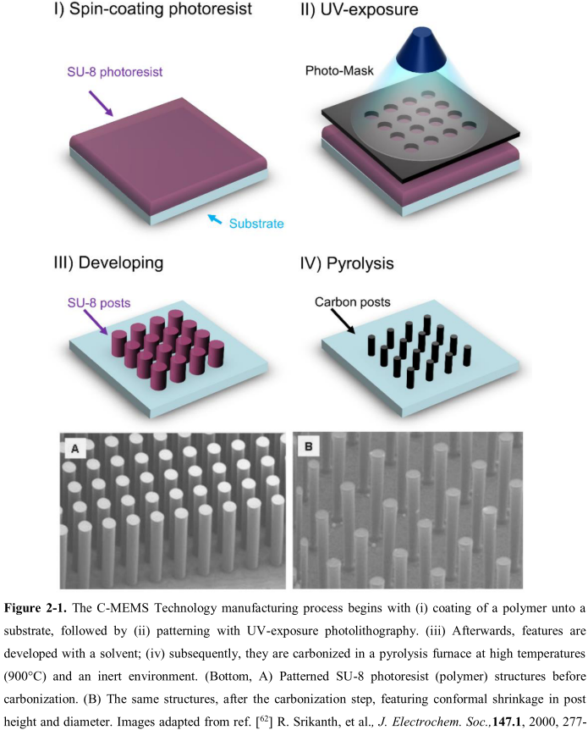
Previous work
The production of C-MEMS:
Polymer patterning through photolithography electrospinning
Carbonization through pyrolysis
SU-8 waste

Slide 3
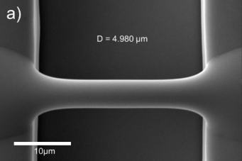
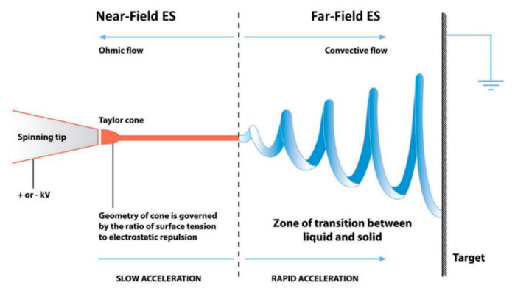
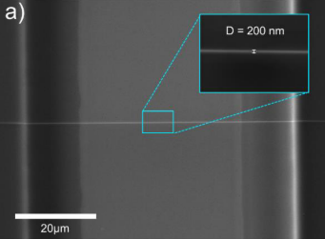
Best Results so far by Braulio & Ricardo
Fiber yield rate of 81 %
Fiber diameter before pyrolisis of 4.966 μm
Fiber diameter after pyrolisis of 204 nm
Fiber length of 60.5 ± 4.3 μm
Fiber resistance from 407 KΩ to 1.727 MΩ

Slide 4
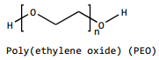
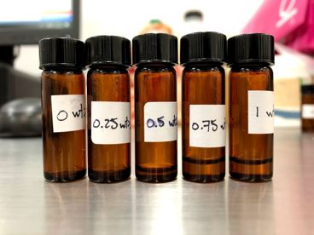
Polymer Solutions
wt% PEO 0.25 | SU-8 2002 [mg] | PEO [mg] | TBT [mg]
 | 2246 | 5.65 | 11.32
= 2 ml of solution
With zero shear viscosity of 0.88 Pa.s electrospun at 600V (solution used to get the results of the previous slide)
Next step -> Discover a new polymer solution to beat Braulio’s record …
Notes:
Surface t-

Slide 5
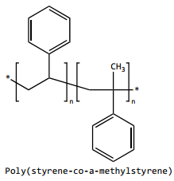
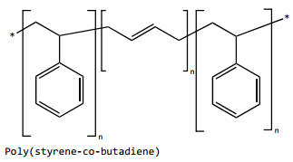
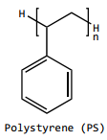
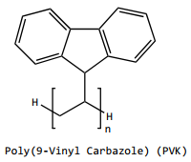
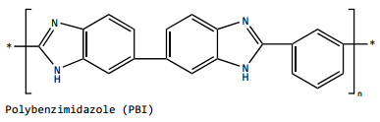
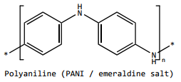
● FFES
● NFES
No records
14 wt% in THF & DMF (Reneker, 1999)
35 wt% in THF (Megelski, 2002)
No records
12.5 wt% in NMP (Raeesi, 2009)
3.96 wt% in Styrene (Min, 2013)

Slide 6

Q&A

Slide 7
References
Cárdenas, B. (2017). Advanced Manufacturing Techniques for the Fabrication and Surface Modification of Carbon Nanowires, 160.
Flores, D. R. (2017). Role of rheological properties in near field electrospun fibers morphology, 130.

Slide 8
wt% PEO Solution
The EMS polymer solution consisted of
2ml of SU-8 2002 mixed with
0.5 wt% of Poly(ethylene oxide) (PEO, 4,000,000 MW; SigmaAldrich Inc., Cat. N. 189464) and
0.5 wt% Tetrabutylammonium Tetrafluoroborate salts (TBATFB; SigmaAldrich Inc., Cat. N. 217964) to increase its conductivity and allow smooth polymer flow during electrospinning.
All reagents were used as received. Magnetic stirring of these components was performed for 1hr at 75°C and low rpm (100-150 rpm).

Slide 9
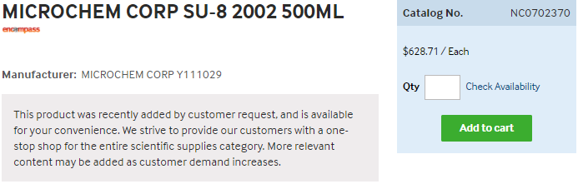
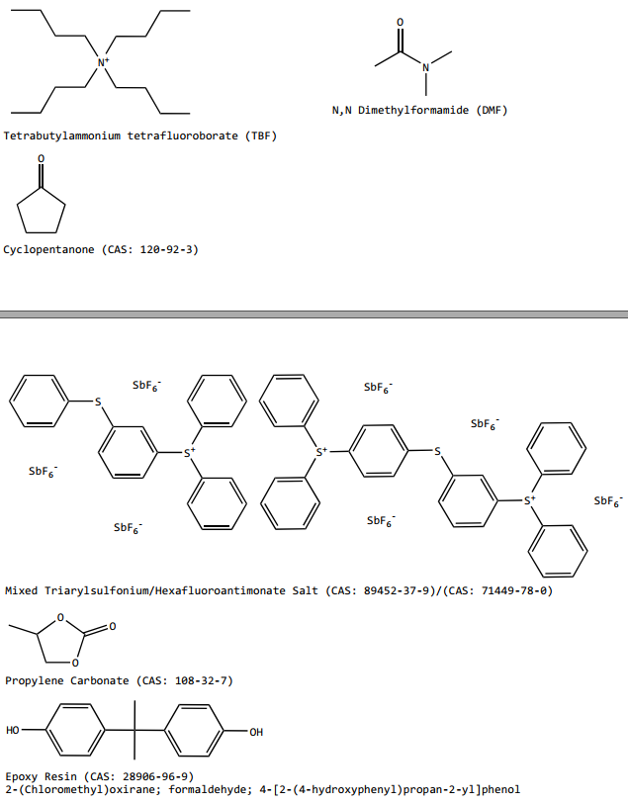
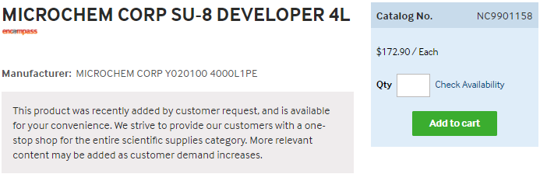
https://www.fishersci.com/shop/products/NC0702370/nc0702370#?keyword=MICROCHEM+CORP+PHOTORESIST+SU-8
https://www.fishersci.com/shop/products/NC9901158/nc9901158#?keyword=SU-8++developer

Slide 10
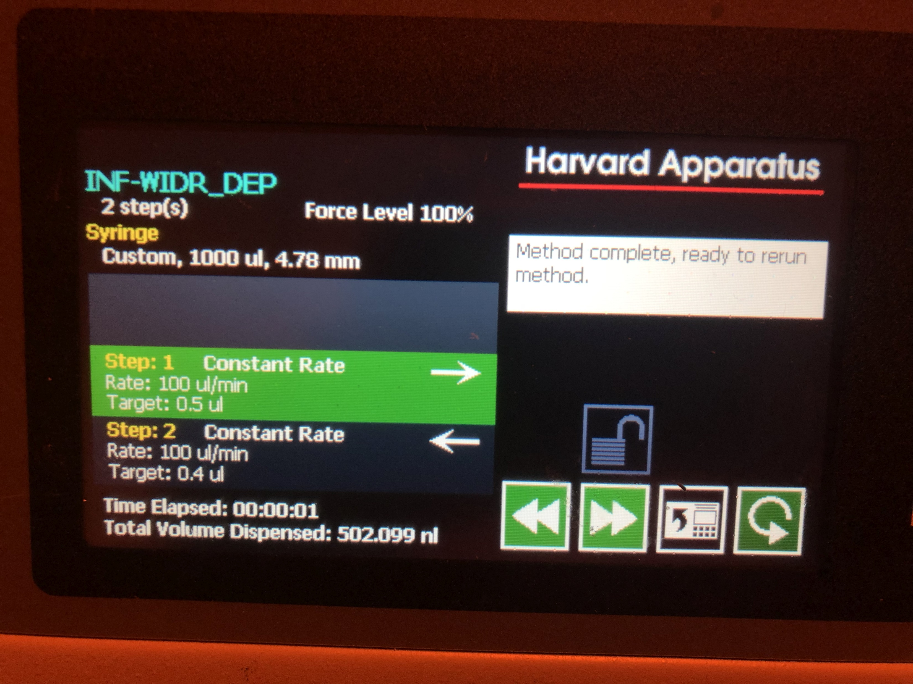
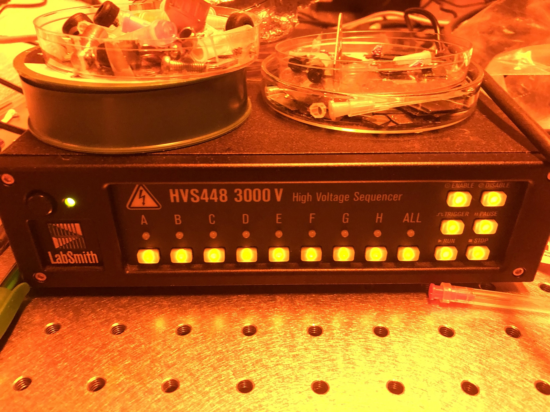
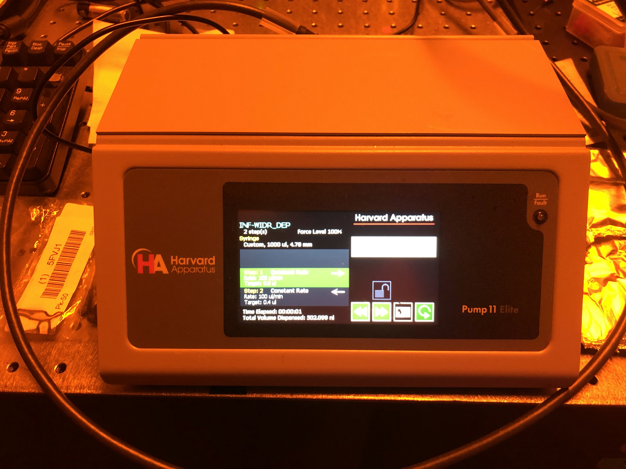

Slide 11
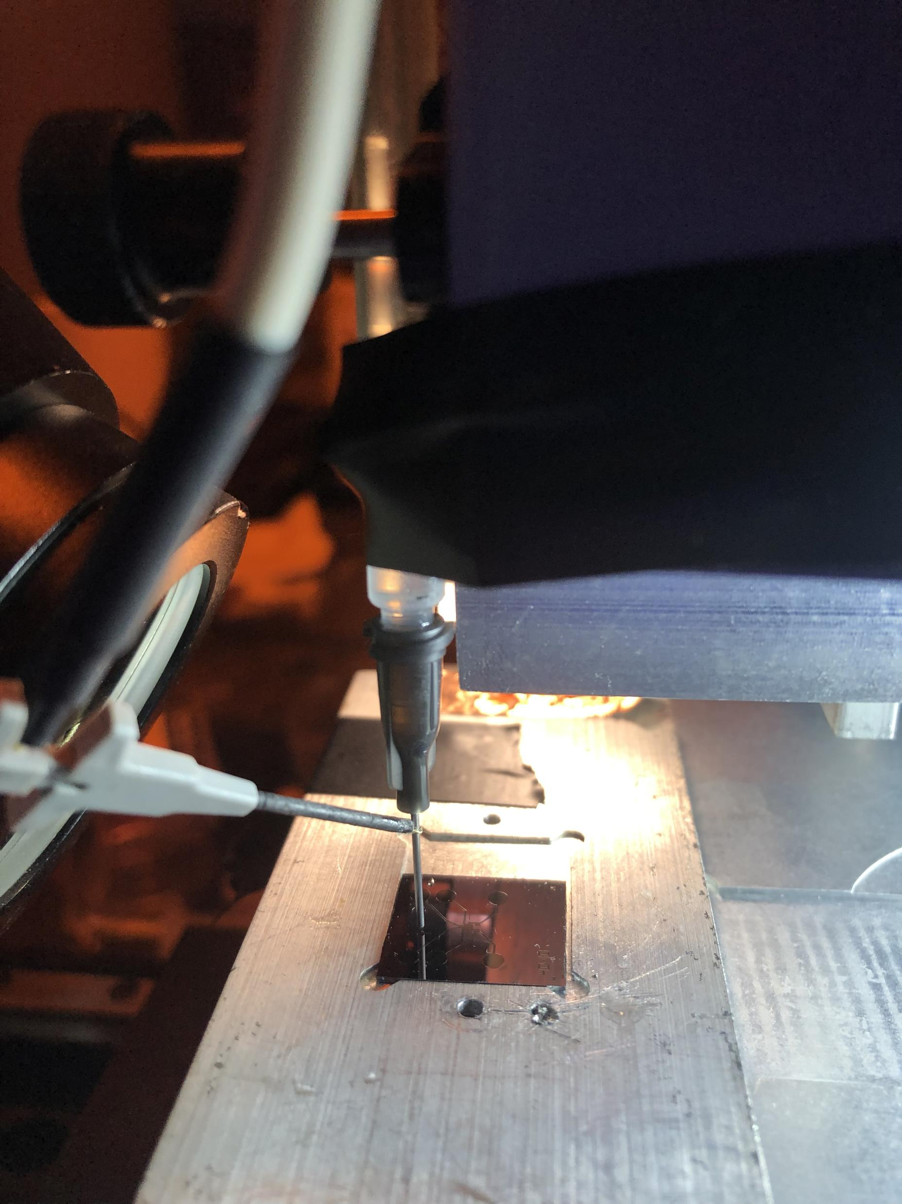
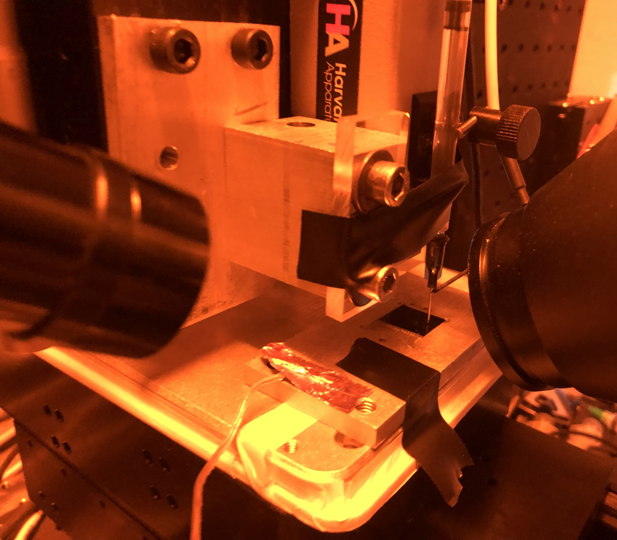

Slide 12
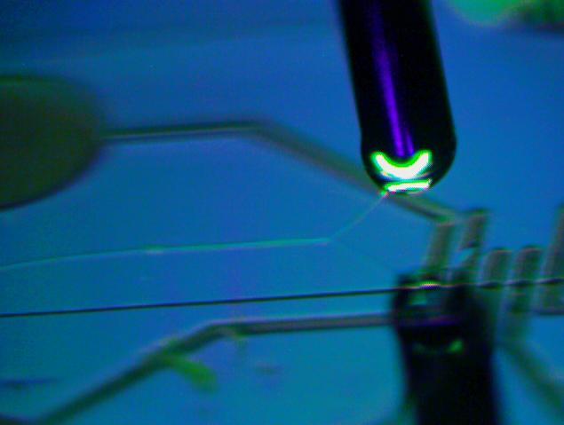
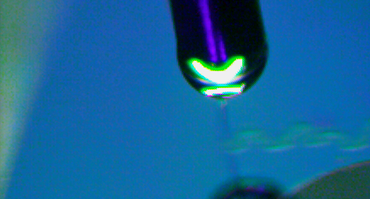
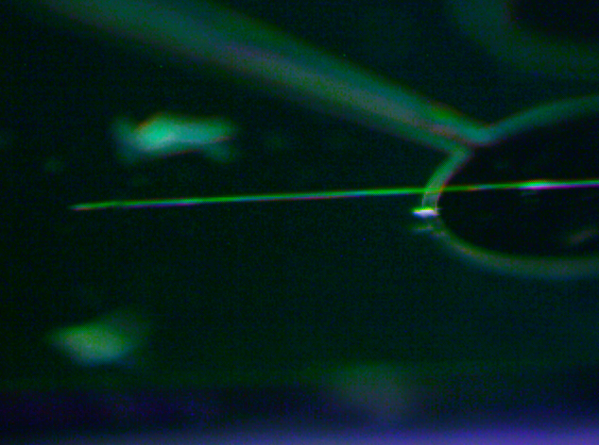
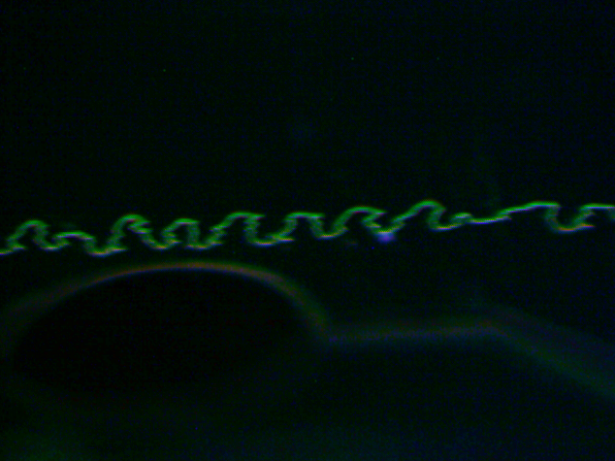
600 V
700 V

Slide 13
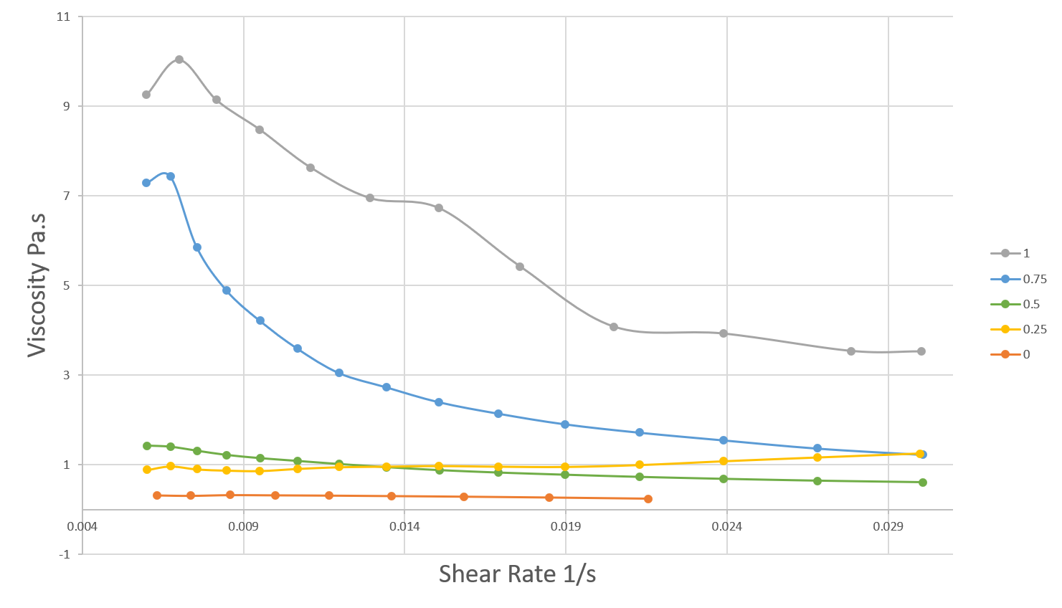

Slide 14
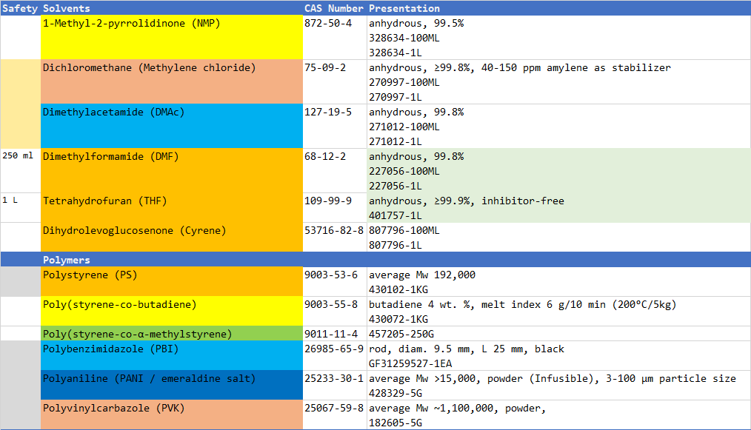

Slide 15
<subTitle>
<content> <key concept>

